Slide 1
Activity 5: IMAGE SEGMENTATION
Genesis Vertudez – 202003099
App Physics 157 - Computational Analysis and Modeling in Physics
Submitted to Dr. Maricor Soriano; Mx. Rene Principe Jr.

Slide 2
OBJECTIVES
Apply threshold to grayscale histogram to separate selections from the background
Normalize an image
Obtain the normalized chromaticity coordinates of an image
Implement parametric segmentation to select chosen colors in an image
Implement nonparametric segmentation to select chosen colors in an image

Slide 3


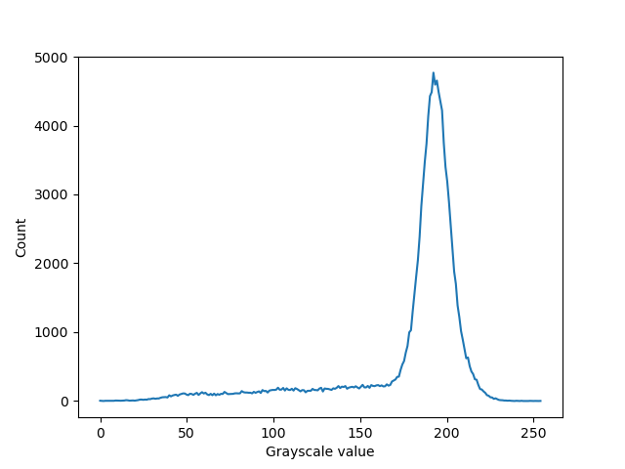
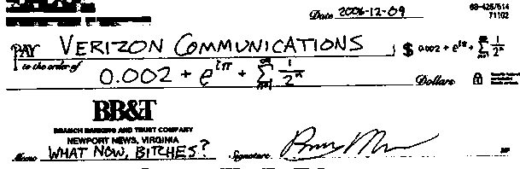
GRAYSCALE HISTOGRAM THRESHOLDING
Codes and files: https://github.com/genvert/AP_157_FX-2_Vertudez/tree/main/Activity%205

Slide 4
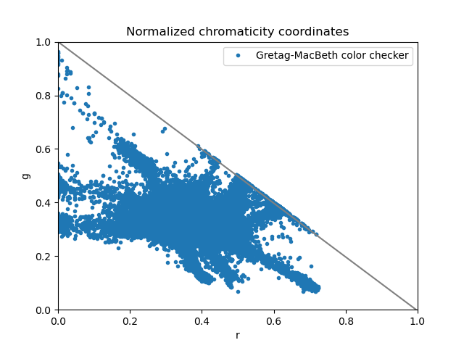
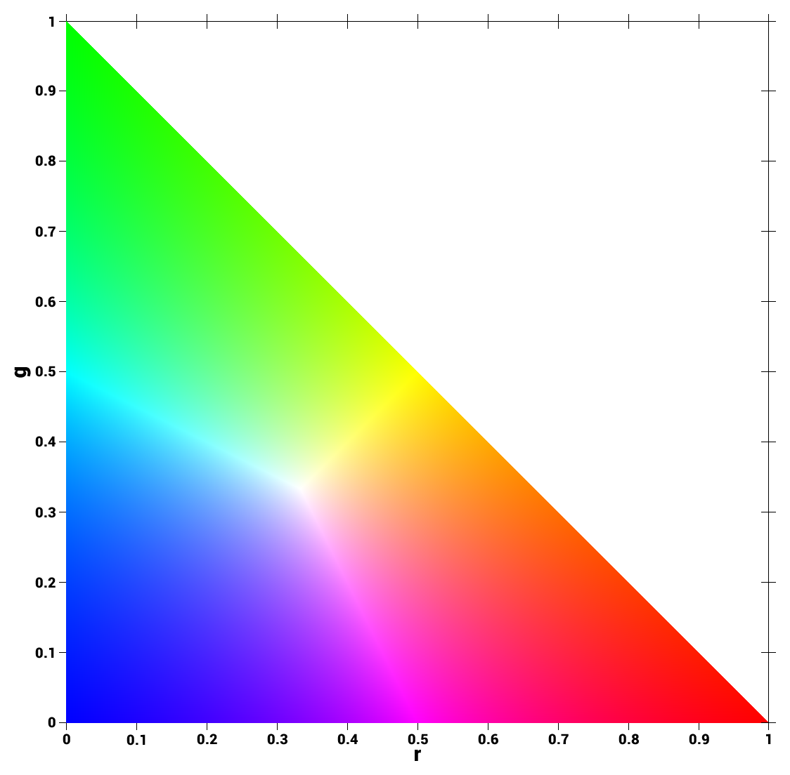
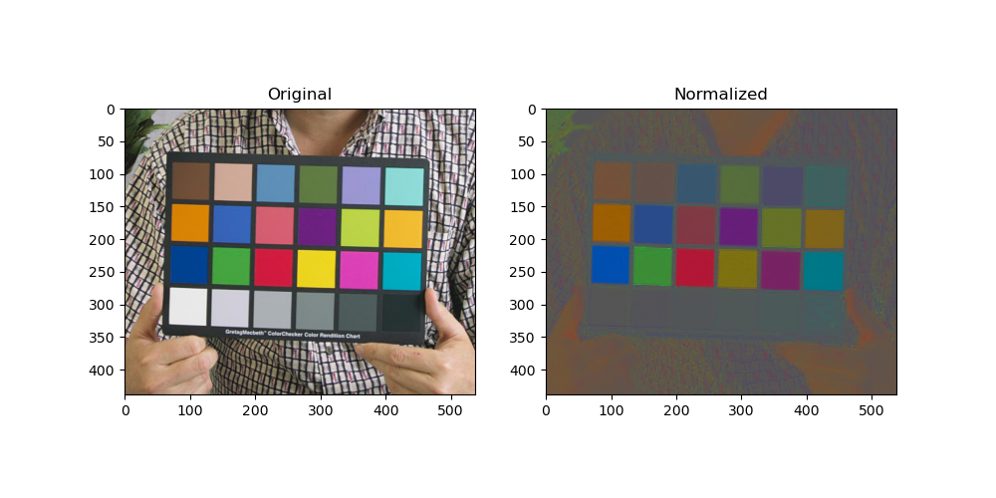
NORMALIZED CHROMATICITY COORDINATES
Codes and files: https://github.com/genvert/AP_157_FX-2_Vertudez/tree/main/Activity%205

Slide 5
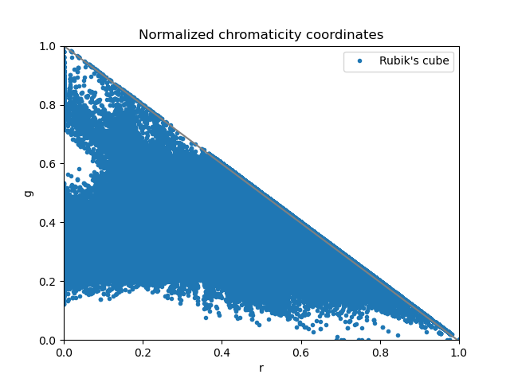
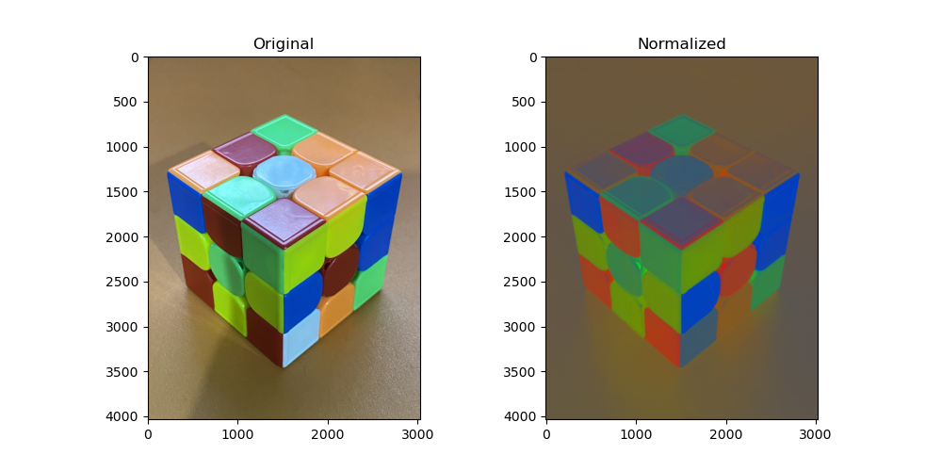
NORMALIZED CHROMATICITY COORDINATES
Codes and files: https://github.com/genvert/AP_157_FX-2_Vertudez/tree/main/Activity%205

Slide 6
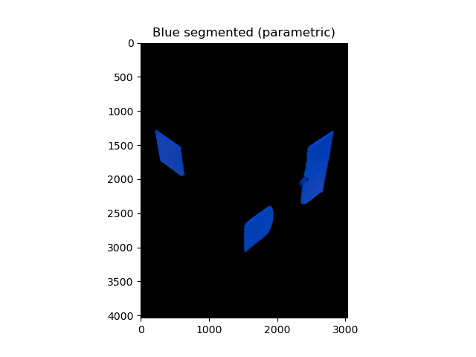
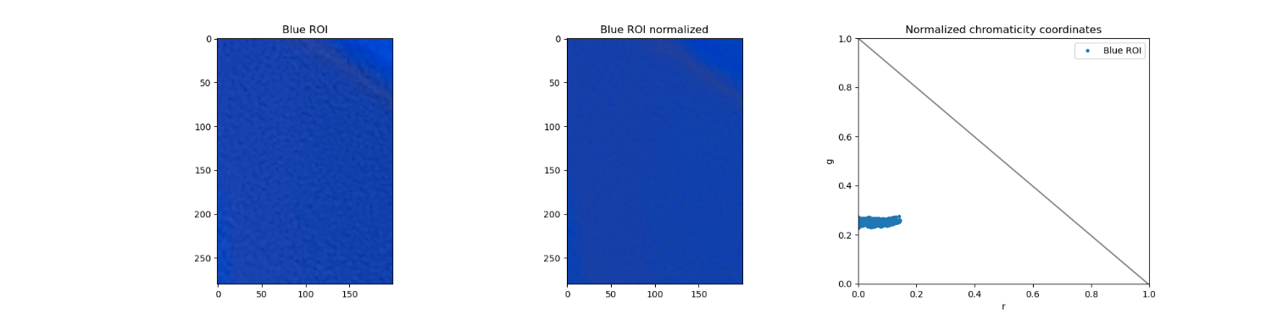
PARAMETRIC COLOR SEGMENTATION
Codes and files: https://github.com/genvert/AP_157_FX-2_Vertudez/tree/main/Activity%205

Slide 7
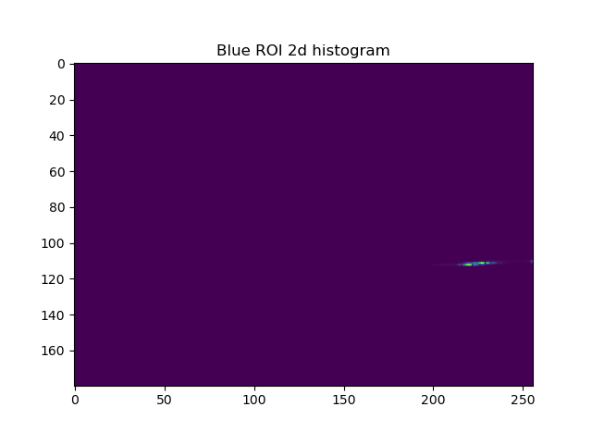

NONPARAMETRIC COLOR SEGMENTATION
Codes and files: https://github.com/genvert/AP_157_FX-2_Vertudez/tree/main/Activity%205

Slide 8


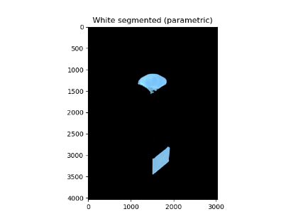
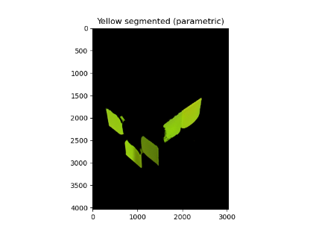
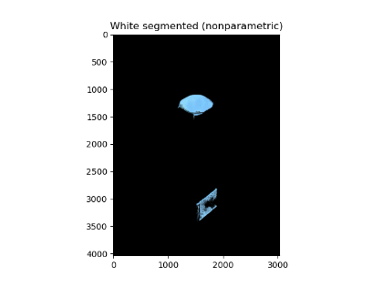
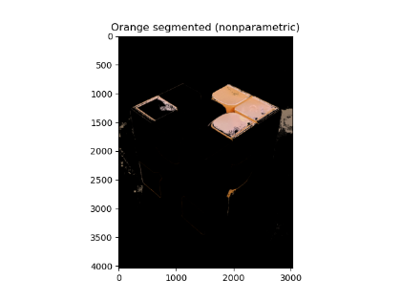
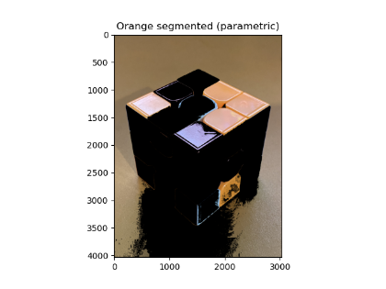
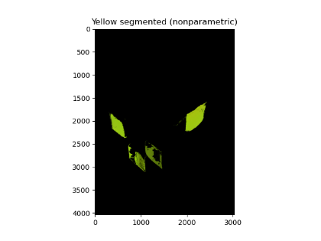
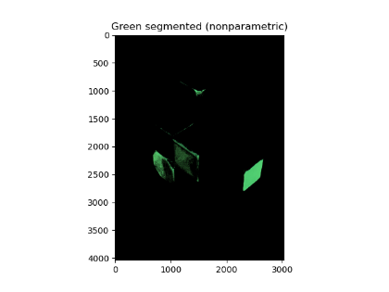
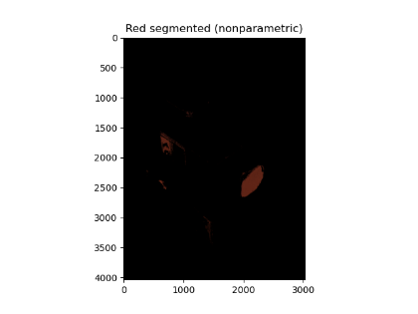
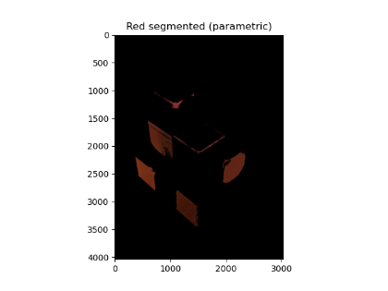
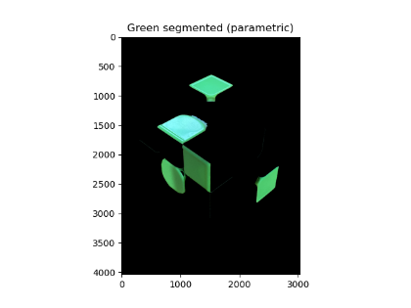
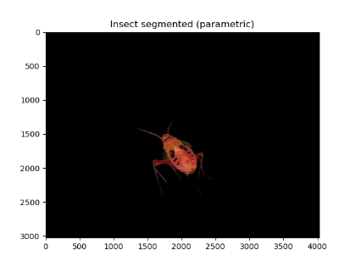
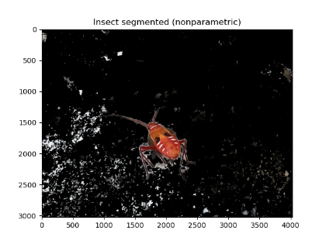
PARAMETRIC VS NONPARAMETRIC
Codes and files: https://github.com/genvert/AP_157_FX-2_Vertudez/tree/main/Activity%205

Slide 9

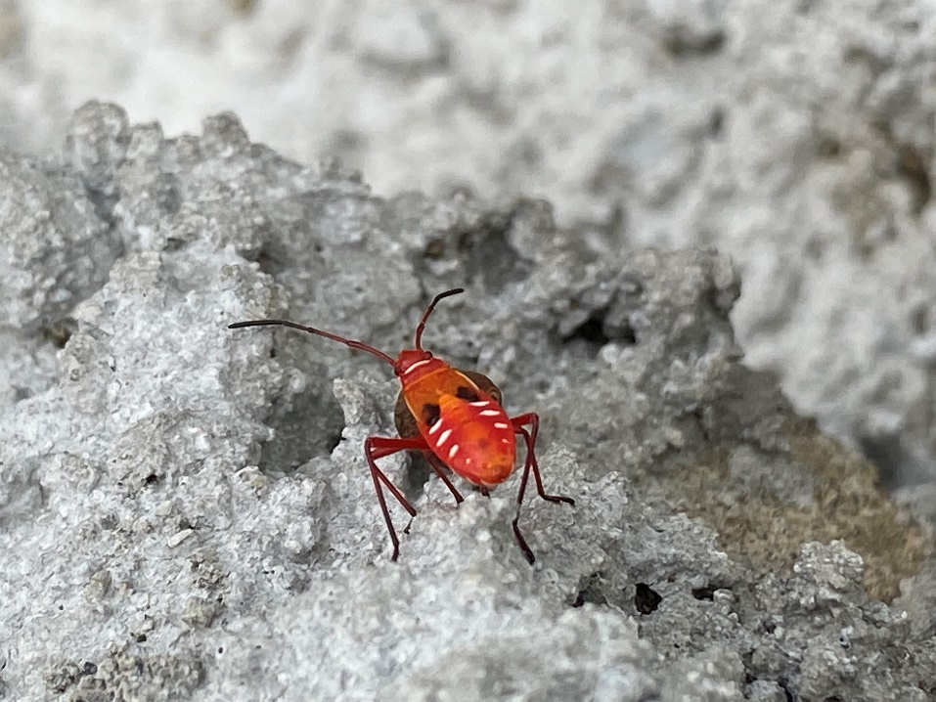
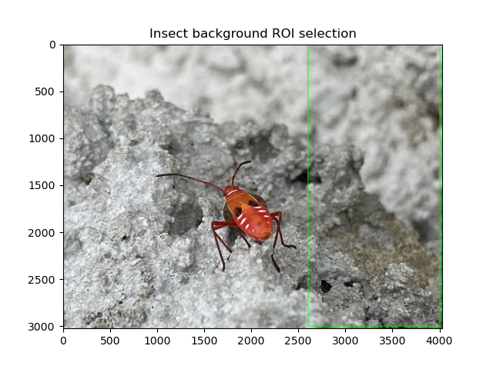
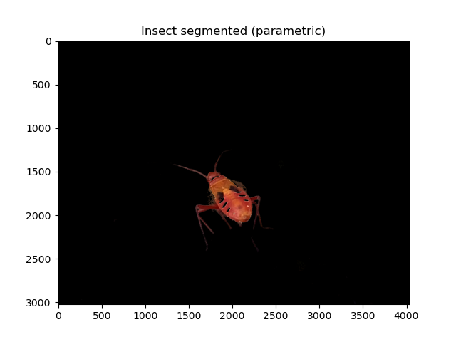
NONPARAMETRIC COLOR SEGMENTATION
Codes and files: https://github.com/genvert/AP_157_FX-2_Vertudez/tree/main/Activity%205

Slide 10
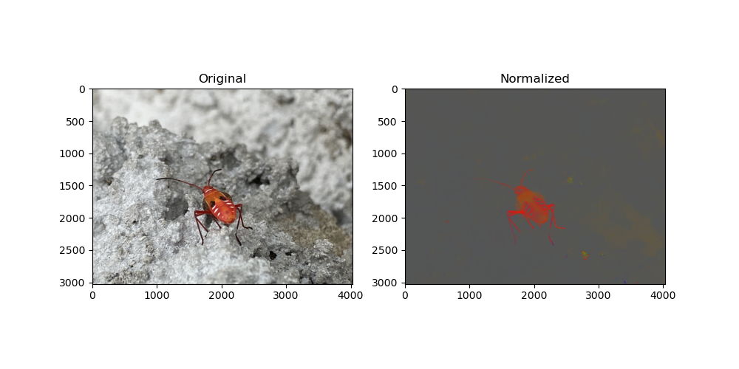
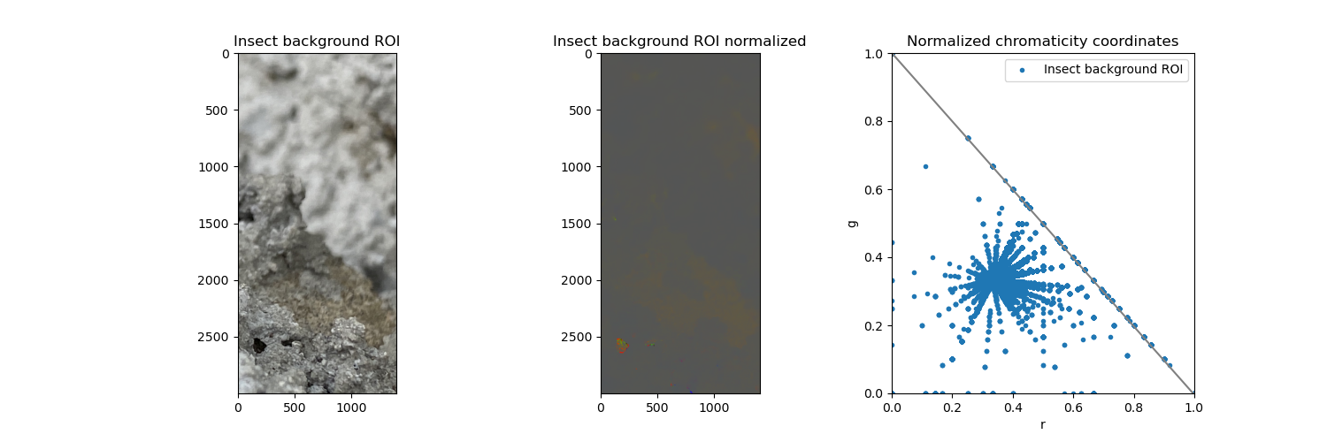
NONPARAMETRIC COLOR SEGMENTATION
Codes and files: https://github.com/genvert/AP_157_FX-2_Vertudez/tree/main/Activity%205

Slide 11
REFLECTION
This activity was straightforward so I was able to follow it easily.
It is fun to recognize and understand the functions of different options in ImageJ based on our fundamental understandings of image processing. It is cool to know that you can do these manually with coding without the app.
I am grateful for this no-coding exercise. This is a breather exercise because I have been overwhelmed by coding lately.

Slide 12
SELF-GRADE
Technical correctness: 35/35
I am confident that I understood the difference between parametric and nonparametric segmentation.
Quality of presentation: 35/35
I have explained the theory and the steps on manually segmenting colors in images using Python. Distinction of the parts of the activity was clear.
Self-reflection: 30/30
This activity was fun. I struggled at first understanding how to obtain the Gaussian probability of each pixel and how to use it to tag the membership of pixels, and how to obtain the 2d histogram of the ROI and how to use it to tag membership as well. Eventually, I got them and segmenting images based on colors was fun.
Initiative: 10/10
I did every color in the Rubik’s. Plus, I took a nice photo of the Dysdercus koenigii and was able to isolate it in the image.

